Slide 1
Covering credit nfts in 30 minutes
Spectral night lessons 1

Slide 2
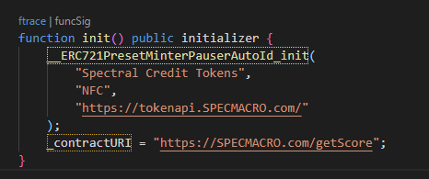
What goes into an NFT (mainly)
It’s basically like assigning each element in an array to a wallet upon _mint()
Typically, a `tokenURI` is set to contain an api/ipfs/database link.
Use a tokenId to address mapping to hold a hash to a specific instance in database.

Slide 3
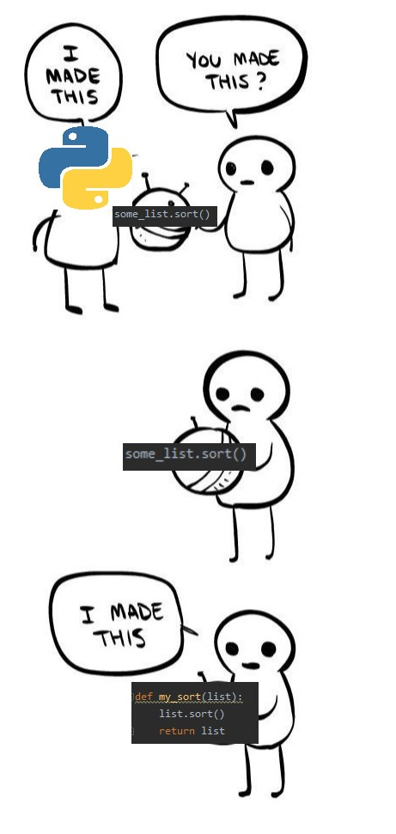
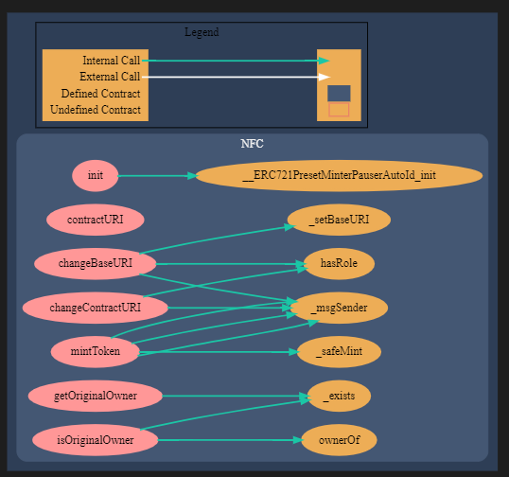
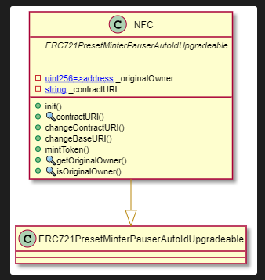


What’s in our NFC v1
Essentially a fork on the Hodlberg contract, just with a few tweaks for transferring ownership. Most of the changes/improvements we’ve made are in the address batching of the frontend. Batched addresses have a bytes32 hash key, which goes into the _originalOwner mapping.

Slide 4
Most of the fun begins in v2
Version 2 will include two main capabilities:
  A market making mechanism for calculating the yield price of borrowing someone’s NFC
  A debt token NFT tied to the original NFC
Architecturally, this will likely be a minimal proxy ERC1155 that contains the NFC and debt token NFT internally.
  Wtf does that mean in English: store two NFTs on the same contract and create a contract factory that is gas efficient (like having most of the functions deployed in a library and the clones call those library functions. It’s technically not a library because libraries cannot mutate storage, so it requires something a little more complex.)

Slide 5
What’s needed for v2
A yield pricing formula, which I’ve started working on in overleaf already with base assumptions. Complexity starts with tranches and how to simulate supply and demand of credit scores on chain.
  This can either follow a supply/demand curve scaled by mints for determining price/yield, or it can replicate a yield curve (scaled by tenor of debt NFT instead). I prefer the yield curve, but it is more prone to wild shifts if there is low liquidity (i.e. it will need some amount of smoothing in the function by bounding values to not have each 50bps make a weird jump).
This also depends on how many different types of debt we issue, since those would need to be attached in the ERC1155 on deploy.
  There may be a way to plug and play debt token types, but then that leaves us exposed to security issues/hacks if the base contract is “tricked” into accepting a false debt token type.

